Slide 1
LIDAR AND MODEL FOR CLASSIFICATION OF 3D POINT CLOUD DATA
Swapnil Dhiman
Under the guidance of MR VANEET NARANG

Slide 2
LIDAR
LIDAR stands for “Light Detection and Ranging”(or light imaging, detection and ranging).
It is an active remote sensing technology that measures distance by illuminating a target with a laser and analyzing the reflected light.
Similar to RADAR, but uses laser light pulses instead of radio waves.
LIDAR uses ultraviolet rays , visible rays and near infrared rays to image object.
By illuminating the target using laser beam ,a 3-D point cloud of the target and it’s surrounding can be generated.

Slide 3
WHY LIDAR?
It is Active sensor , do not require sunlight, they can be used either during the day or at night.
Best resource for gathering the information of our target
Information that can be extracted from LIDAR:
Range to target (Topographic LIDAR)
Structure of target
Velocity of target

Slide 4
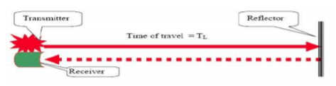
Working Principle:
Laser generates an optical pulse.
Pulse is transmitted , reflected and returned to the receiver.
This return beam/pulse is collected and processed to obtain property of target.
Receiver accurately measures the travel time.
Calculate Distance :- Distance=(Speed of Light * Time of flight) / 2

Slide 5
.
Calculation of X,Y,Z coordinates(3D point cloud data) can be computed from
Laser range
Laser scan angle
Absolute location of sensor

Slide 6
ARTIFICIAL NEURAL NETWORKS( ANN)
Neural networks are a series of algorithms that mimic the operations of a human brain to recognize relationships between vast amounts of data.
Helps to come up with non linear decision boundaries
A neural network contains layers of interconnected nodes. Each node is a perceptron. In a multi-layered perceptron (MLP), perceptrons are arranged in interconnected layers. The input layer collects input patterns. The output layer has classifications or output signals to which input patterns may map.

Slide 7
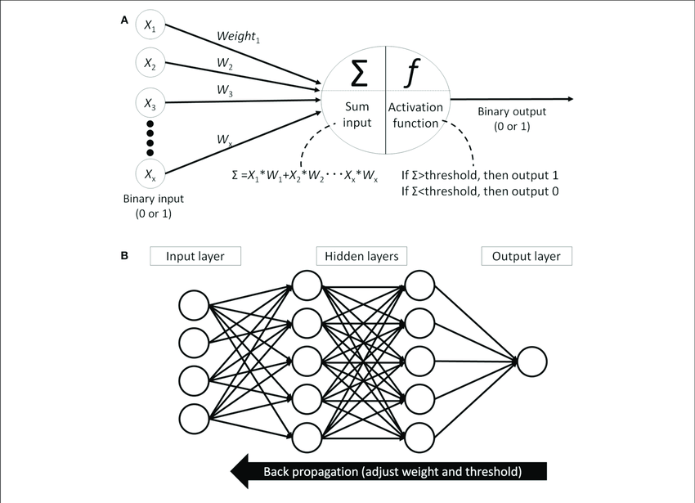

Slide 8
Important terms regarding ANN:
Connections and weights
The network consists of connections, each connection providing the output of one neuron as an input to another neuron. Each connection is assigned a weight that represents its relative importance. A given neuron can have multiple input and output connections
Forward Propagation :
The method computes the input to a neuron from the outputs of its predecessor neurons and their connections as a weighted sum . A bias term can be added to the result of the propagation.
Back Propagation :
A method used to adjust the connection weights to compensate for each error found during learning. Technically, backprop calculates the the derivative of the cost function associated with a given state with respect to the weights. The weight updates can be done via stochastic gradient descent

Slide 9
CONVOLUTION NEURAL NETWORK( CNN) (great to use in cases of images as an input)
A convolutional neural network (CNN) is a type of artificial neural network used in image recognition and classification and processing that is specifically designed to process pixel data.
A CNN uses a system much like a multilayer perceptron that has been designed for reduced processing requirements. The layers of a CNN consist of an input layer, an output layer and a hidden layer that includes multiple convolutional layers(consisting of filters), pooling layers, fully connected layers and normalization layers. The removal of limitations and increase in efficiency for image processing results in a system that is far more effective, simpler to train data based on images.
Here each convolutional perceptron learns distinct features of image like sharpness ,curves, intensity and this makes it superior to use rather than simple ANN because there we consider each pixel(a data point) as a feature.

Slide 11
MODEL
Requirements:
Language Used: Python
Libraries needed:
TensorFlow : foundation library created by google that can be used to create Deep Learning models (better to use TensorFlow running on GPU)
Keras: helps to do efficient numerical computations of TensorFlow
Trimesh: python library for loading and using triangular meshes so point cloud data can be viewed as polygon figures
Matplotlib: library for data visualization and graphical plotting for points of arrays
NumPy: provides support for large multidimensional array objects and various tools to work with them

Slide 12
Data Set: MODELNET10
Here the dataset used(at present which is closest to dataset that will be produced by LIDAR i.e. 3d point cloud data) is ModelNet10 model dataset which is subset of ModelNet40 dataset. This is subset dataset of ModelNet40.
Contains near about 4,899 pre-aligned shapes from 10 categories(example sofa, chair, night_stand...).There are 3,991 (80%) shapes for training and 908 (20%) shapes for testing.
Each shape is stored in .off format(object file format which is a geometry definition file format containing description of the composing polygons of a geometric object. It can store 2d or 3d objects).
This dataset is provided by Princeton university.
For further information regarding the dataset kindly refer to https://modelnet.cs.princeton.edu/

Slide 13
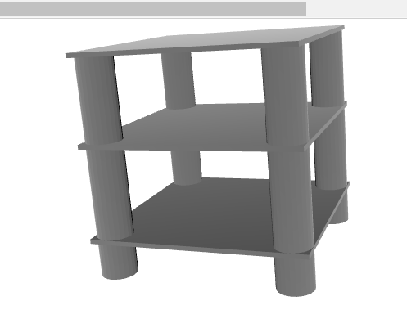
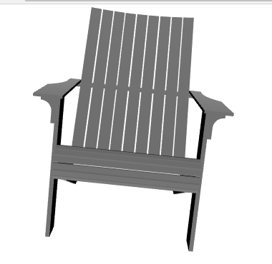
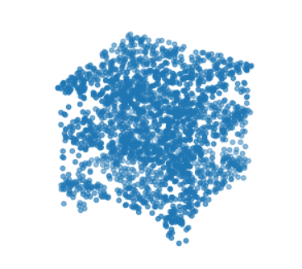
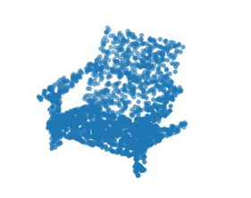
Visualization: Using trimesh library to read and visualize the .off(object file format) mesh files. It's a library for importing, exporting and doing simple operations on triangular meshes. Night_stand and its 3D point cloud Chair and it’s 3D point cloud

Slide 14
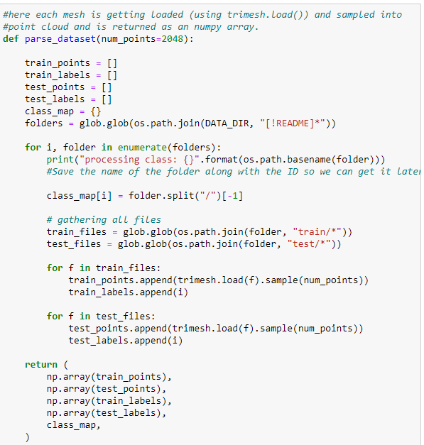
Parsing the Data Set into desired format: We must first parse through the ModelNet data folders in order to construct a tf.data.Dataset(). Each mesh is imported into a point cloud and sampled, then added to a standard Python list and converted to a NumPy array. The current enumerate index value is likewise saved as the object label, and we utilise a dictionary to retrieve it later.

Slide 15
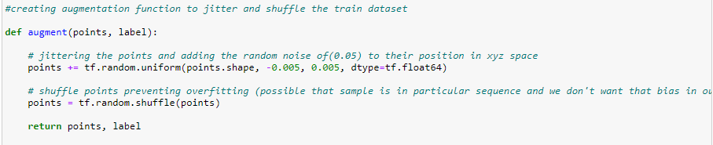
Changing the dataset to avoid overfitting in data space without much loss of information

Slide 16
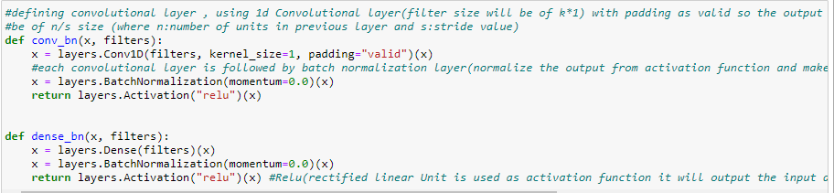
Function to build the model
Defining convolutional layer , using 1d Convolutional layer(filter size will be of k*1) with padding as valid so the output will approximately be of n/s size (where n:number of units in previous layer and s:stride value)
Each convolutional layer is followed by batch normalization layer(normalize the output from activation function and make sure weights in the process remains on same scale)
We have build function for creating tnet layers which takes transformation and rotation of our point cloud into account.

Slide 17
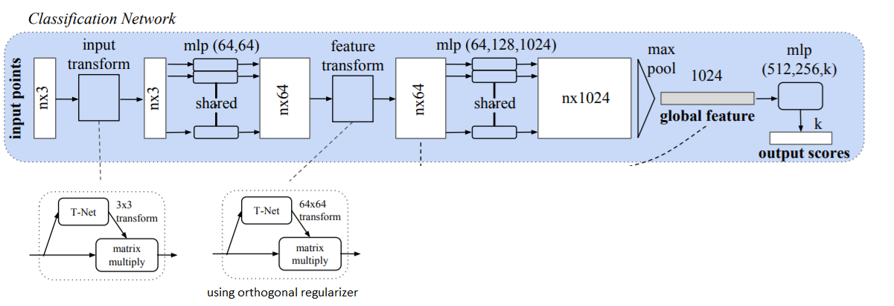

Slide 18
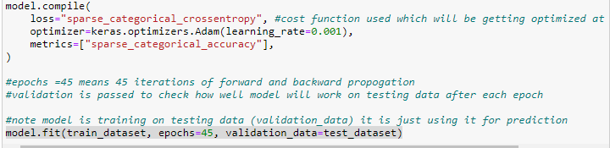
Compiling and training the model
Cost function used : cross entropy
Epochs (Number of forward and backward propagation) =45
Validation data is passed to check how well model will work on testing data after each epoch.
model.fit(train_dataset, epochs=45, validation_data=test_dataset)

Slide 19
Result:
Result observed is that in only 45 epochs our loss has been reduced from 3.4033 to 1.2727 and training accuracy has been increased from 34% to 93% . While we can see that we have reached testing accuracy of max 90.88% at epoch 35.

Slide 20
References
Paper (Classification Network Implemented): https://arxiv.org/pdf/1612.00593.pdf
https://www.tensorflow.org/ : TensorFlow
https://en.wikipedia.org/wiki/Lidar : Lidar
https://en.wikipedia.org/wiki/Artificial_neural_network : Ann
https://en.wikipedia.org/wiki/CNN : Cnn
https://modelnet.cs.princeton.edu/#:~:text=The%20goal%20of%20the%20Princeton,3D%20CAD%20models%20for%20objects : Data Set

Slide 21
Acknowledgement
In the end I would like to express my special thanks of gratitude to my mentor Mr Vaneet Narang as well as Samsung who gave me the golden opportunity to do this wonderful project on Lidar and it’s classification using modified CNN, which also helped me to find out so many new things.

Slide 22
THANK YOU

